Slide 1




GATI SHAKTI VISHWAVIDYALAYA
Slide 01
BATTLE BOT (ROBOCAR)
Source code on(GitHub)

Slide 2
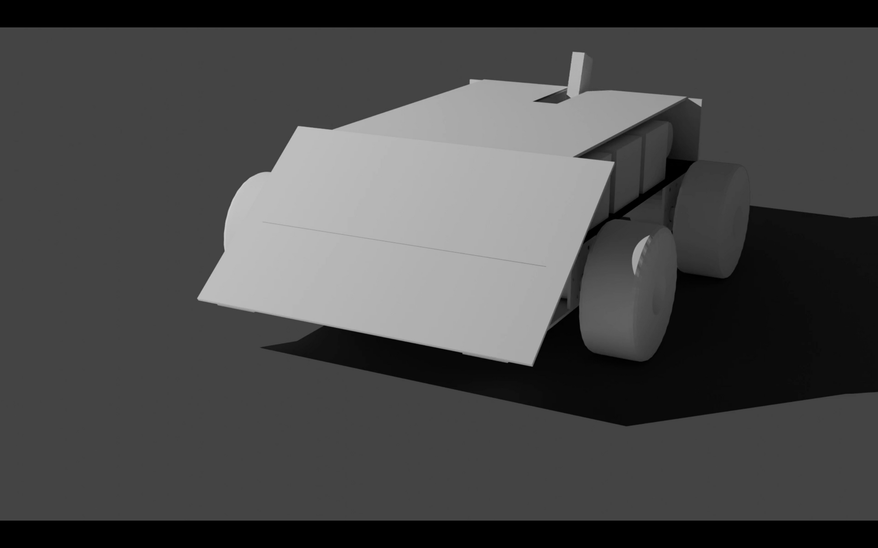




Spinner as a Weapon
RAMP 37 DEGREE FROM GROUND
85 mm diameter Wheel
MECHNICAL PARTS
Body is made up of GI sheet of thickness 0.7mm

Slide 3
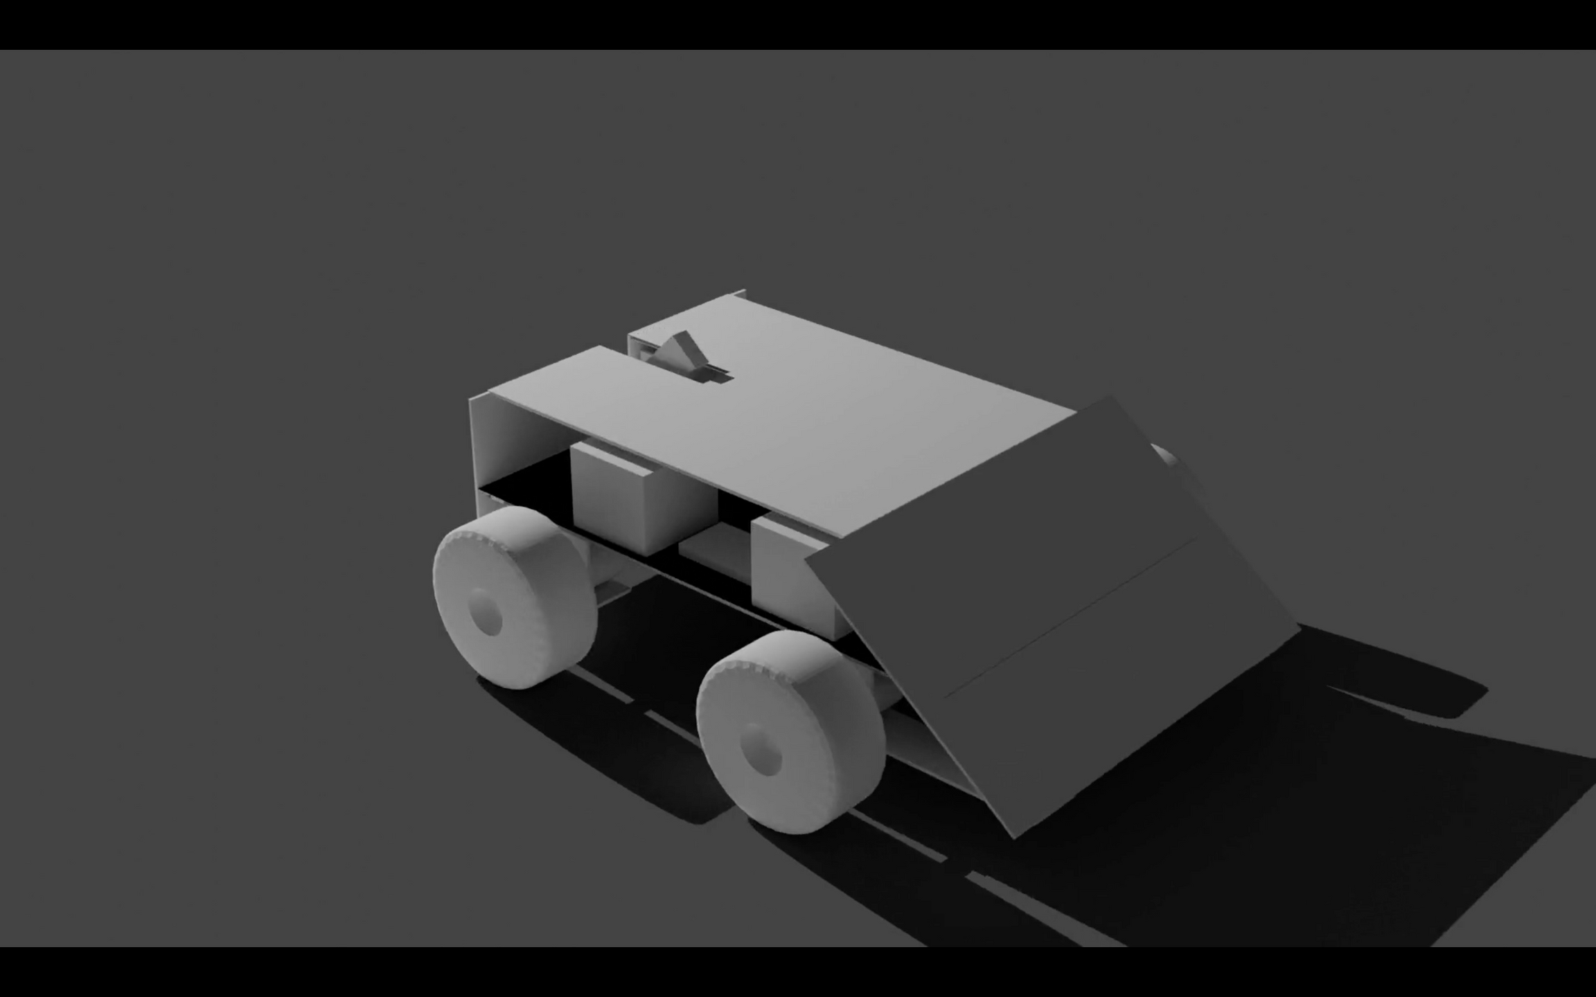


BATTREY
MICROCONTROLLER
Nominal Capacity (mAh): 4200
Nominal Voltage (v): 11.1
Max Charging Voltage (v): 12.6
Charge Port: 4 Pin JST XH
Discharge Port: Amass XT60
ESP32-DEV MODULE
MOTOR
PRO-RANGE 12V 300 RPM JOHNSON GEARED DC MOTOR – GRADE A QUALITY-ENCODER COMPATIBLE
BUCK CONVERTOR
MOTOR DRIVER
INPUT VOLTAGE : 3V TO 40V, Output voltage : 1.5V to 35V(Adjustable) ,
Output current : 2A to 3A
BTS7960 H-Bridge Motor Driver Module Input voltage(V): 6 – 27. Maximum current(A): 43.
Input level(V): 3.3 – 5.
www.reallygreatsite.com
ELECTRICAL PARTS

Slide 4
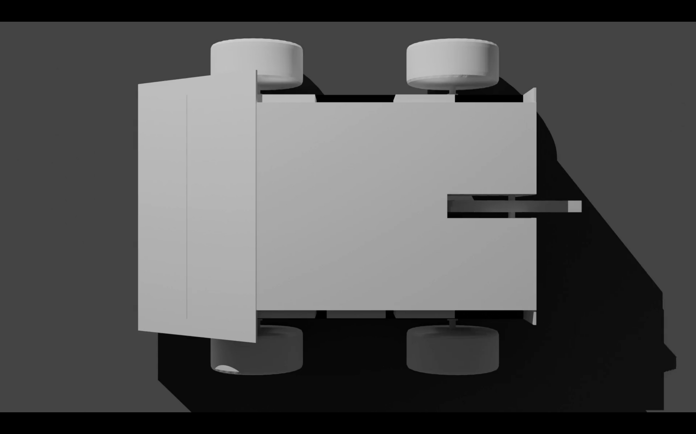
Motor
Motor Driver
Motor
Motor
ESP32
Motor Driver
Buck Convertor
Battery
Motor Driver
Motor
Motor
CIRCUIT DIAGRAM

Slide 5
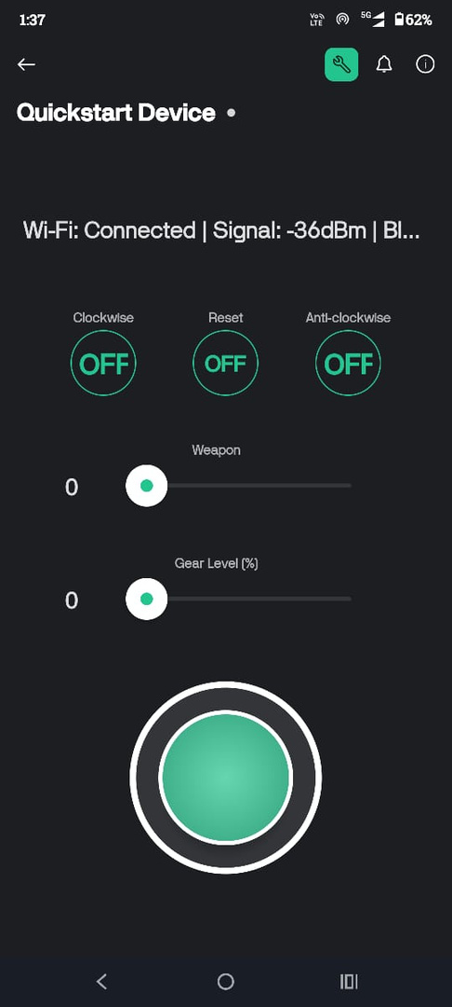
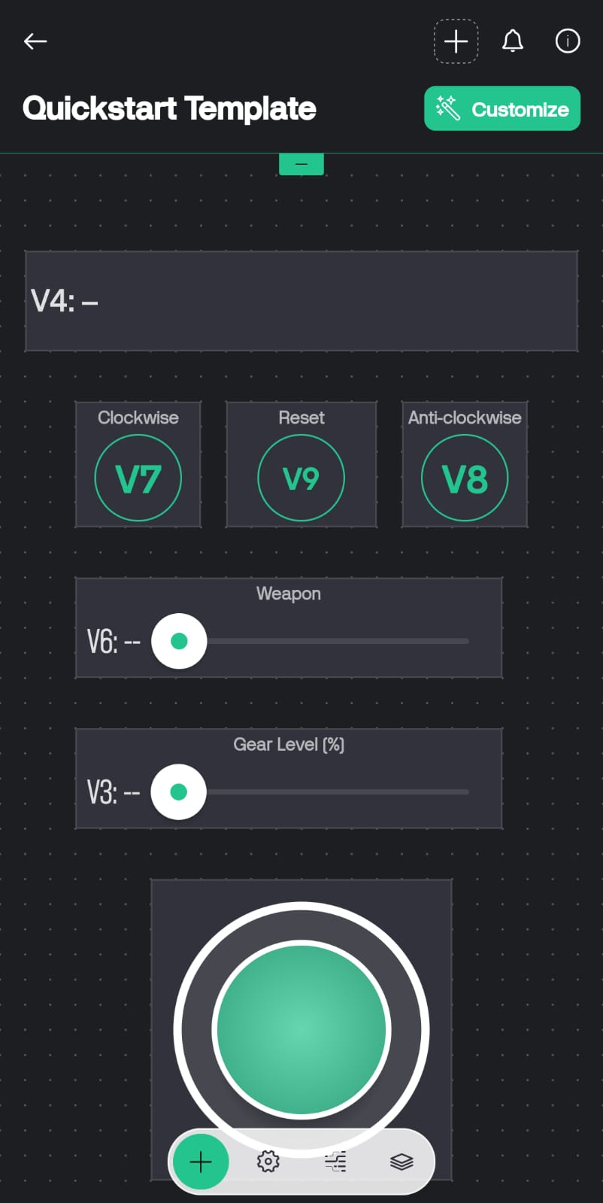

Slide 6
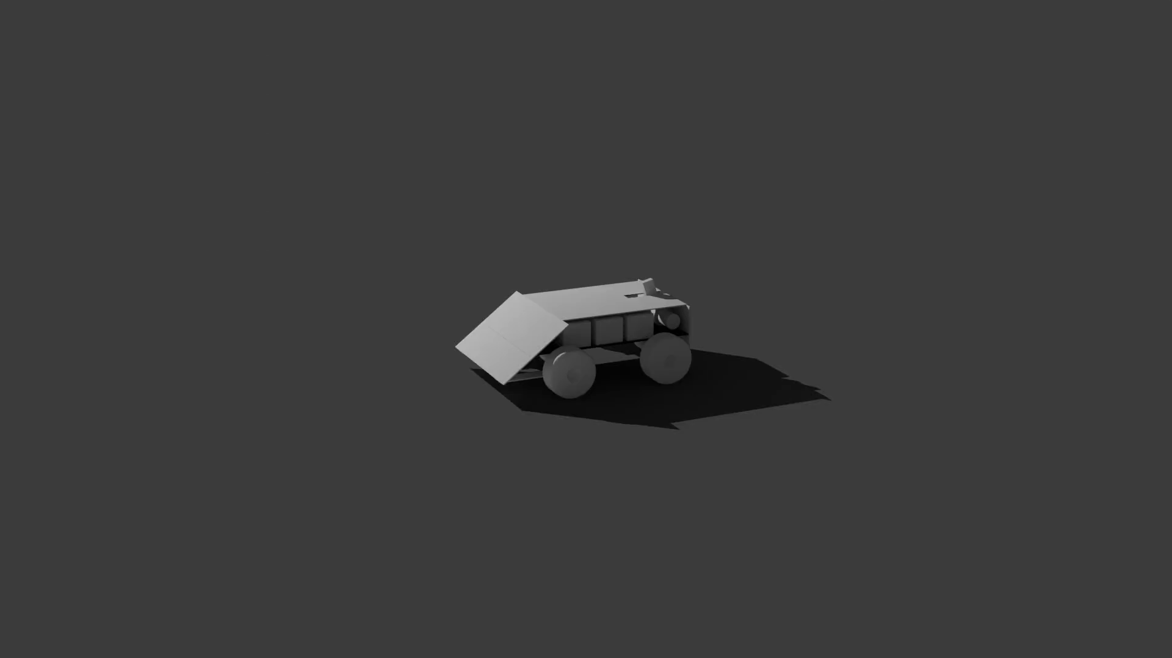

Slide 7



Slide 13
THANK YOU!
www.reallygreatsite.com

